Slide 1
Sub-auroral flow shear observed by King Salmon HF radar and RapidMAG
SuperDARN King Salmon HF radar at Alaska
T. Hori¹, T. Kikuchi¹, Y. Tsuji¹, A. Shinbori², K. Ohtaka³, M. Kunitake³, S. Watari³, T. Nagatsuma³, O. Troshichev⁴
1. STE lab., Nagoya Univ., Japan 2. RISH, Japan 3. NICT, Japan 4. AARI, Russia

Slide 2
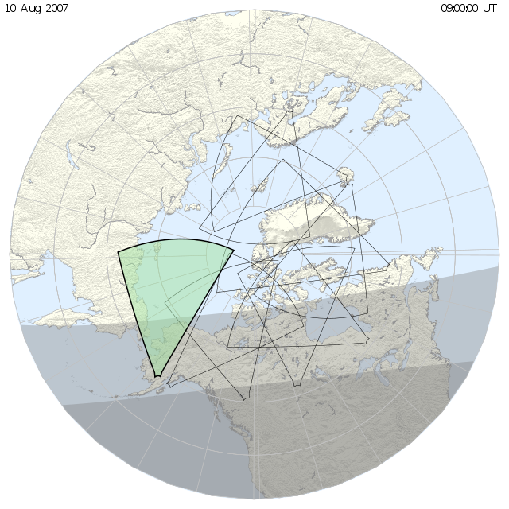
Contents
Introduction
Observation
Case study
Flow shear during a substorm
Statistics
Location
Comparison with satellite obs.
Geomag. correlation
Discussion
Conclusion

Slide 3
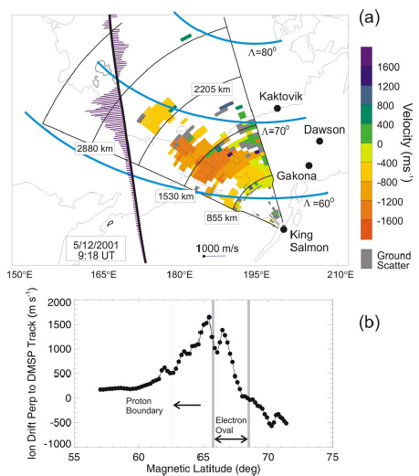
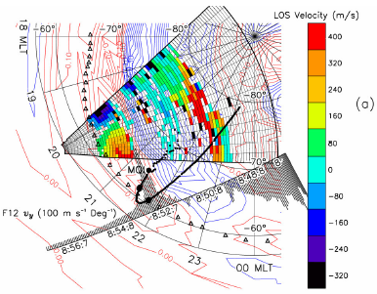
Introduction: As a more transient convection feature: Duskside fast westward flow → SAPS
SubAuroral Polarization Streams (SAPS) seen by KSR and DMSP satellite [Koustov et al., 2006]
Auroral Westward Flow Channel (AWFC) seen by TIGER [Parkinson et al., 2007]
Sub-Auroral Polarization Stream (SAPS)
[Foster and Burke, EOS, 2002]
Correlated with geomagnetic activity [Foster and Vo, JGR, 2002]
lasts for ~10s of min to a few hours

Slide 4
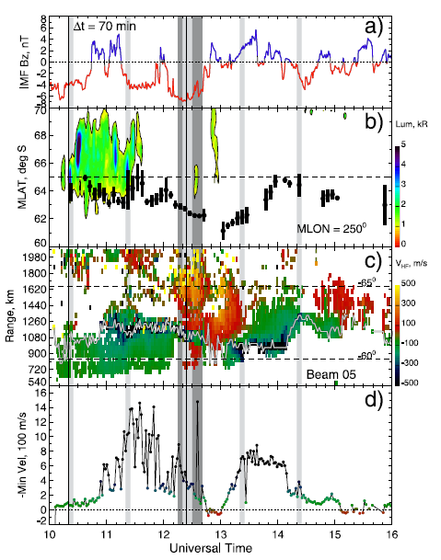
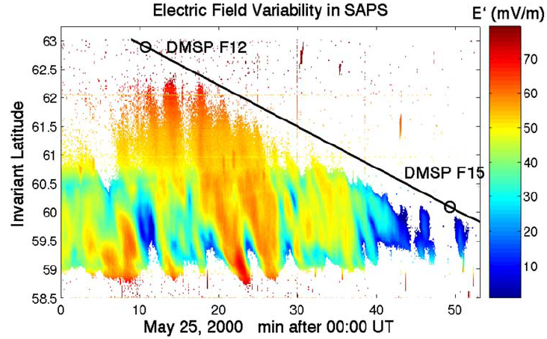
Introduction: Dynamic aspects of SAPS
Foster et al. [2004]
Makarevich et al. [2009]
SAPS is dynamic: changes its shape and E-field/flow speed

Slide 5
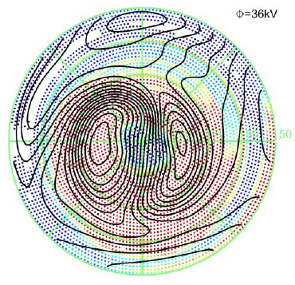
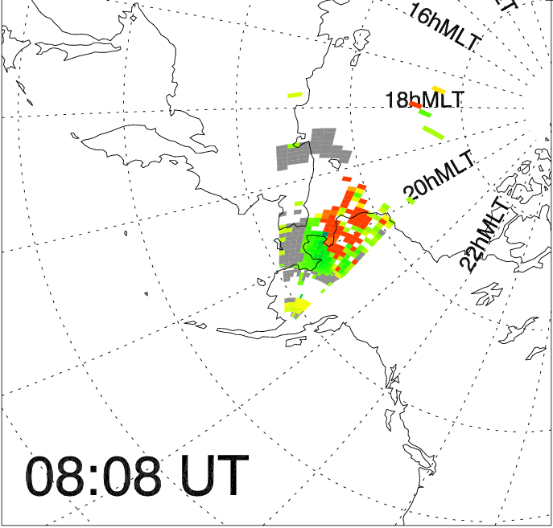
Introduction: As a much more transient feature: Eastward-westward flow shear (present study)
Present study:
What conditions/phenomena flow shears correlate ?
How is this flow structure generated?
…
Flow toward radar (eastward)
Flow away from radar (westward)
We found that transient (~ a few tens of min) flow shears emerge occasionally in dusk-evening sector by the King Salmon radar.
The basic structure is quite similar to the mirror channel reported by Makarevich et al. [2009], but emerging in earlier local time .

Slide 6
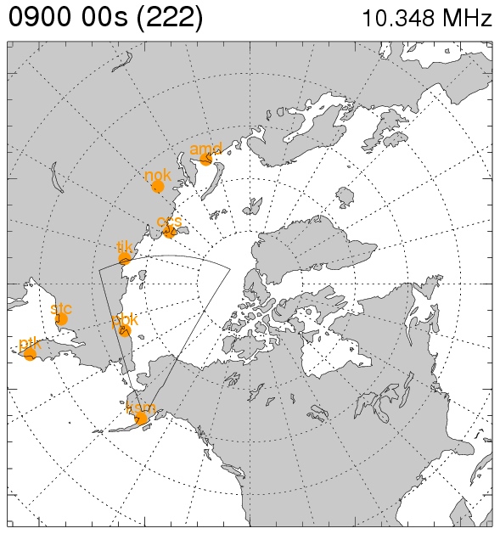
Observation
AACGM coords.
AMD
NOK
TIK
PBK
RapidMAG: Northern coast of Russia (AMD,NOK,TIK,PBK)
→ Can monitor the DP2/large-scale convection variation
King Salmon (KSR) HF radar:
Eastward-Westward ionospheric flows at Magnetic Latitude > 60 deg
→ Provides lat./lon. structure of flows

Slide 7
An example of flow shear
eastward

Slide 8
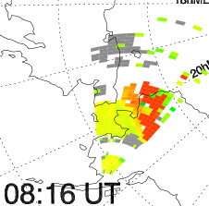
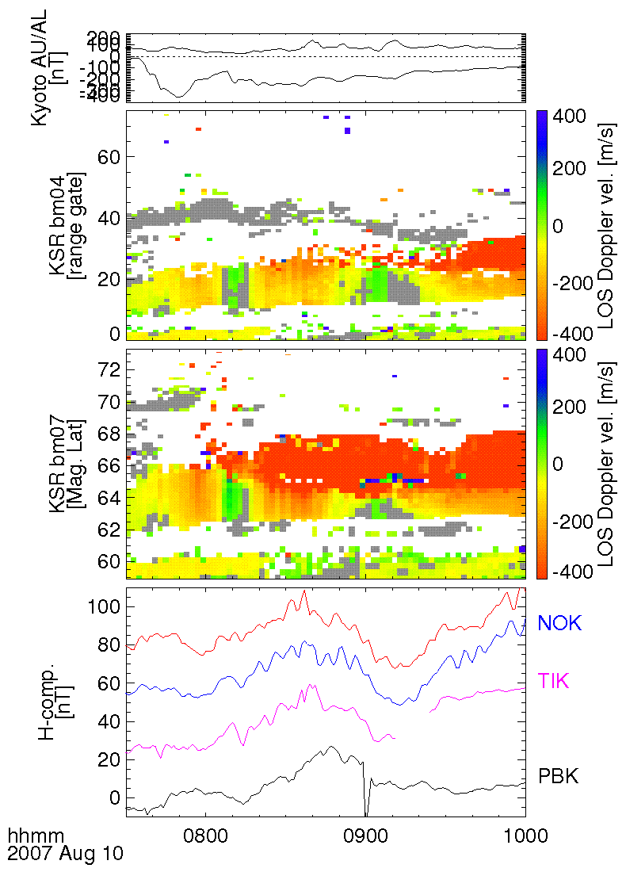
Case study: KSR Doppler vel. and geomag.
bm04
bm07
19hMLT
70
20hMLT
AACGM
60
Two transient flow shears (FSs)
Fast westward / slow eastward flow on higher/lower lat. side
1st FS: on a small intensification of AL
2nd FS: DP2 decay during late recovery phase
Velocity shear aligned to the L-shell direction (constant Mlat)
Likely a L-shell aligned flow structure

Slide 9
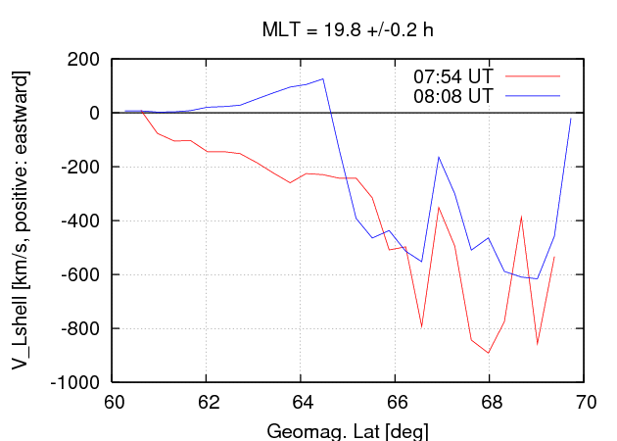
Latitudinal velocity structure of an ordinary SAPS and a SAPS with flow shear
The westward flow slows down on the flow shear emergence
SAPS consists of higher-lat. portion and lower-lat. portion?

Slide 10
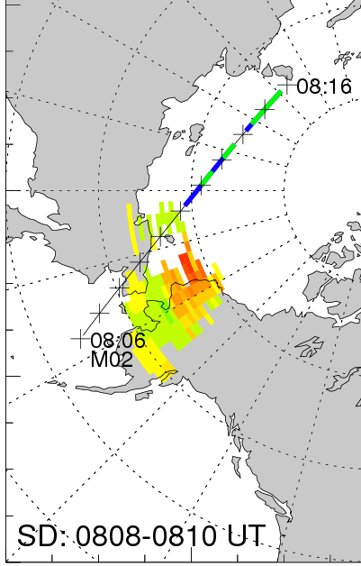
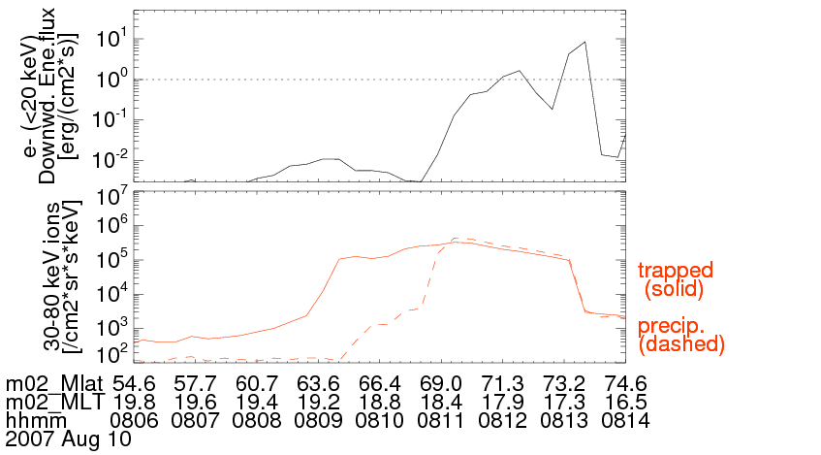
Comparison with auroral oval latitude simultaneously observed by NOAA/POES
Auroral electron and ring current ion by NOAA/POES
flow shear
Fast westward flow(SAPS)
e- auroral oval
eastward flow
Ring current ion
AACGM-Eastward flow (assuming L-shell flow with smoothing in MLT
averaged in the lat – MLT bin
The flow shear stands at by ~4 deg lower latitude side of the oval
→ in the subauroral region

Slide 11
Statistical study
Visually inspect RTI plots of KSR data for Apr2007 – Jul2008
Yielded over 40 events showing the same kind of flow shear
Accompanied by:
RapidMAG (constantly available through 2007…)
Alaska, and Canadian geomag at auroral latitudes, and ACE data
26 flow shear events
The following statistics are based on the 26 samples

Slide 12
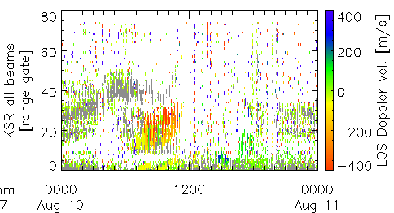
Statistics: Position of flow shears
Flow shear position
noon
Mostly found at MLT~18h-21h, but could just reflect echo occurrence
AACGM coords.
This radar often lose echoes after ~11 UT (MLT ~ 21h) …
dusk
dawn
80
70
60
midnight

Slide 13
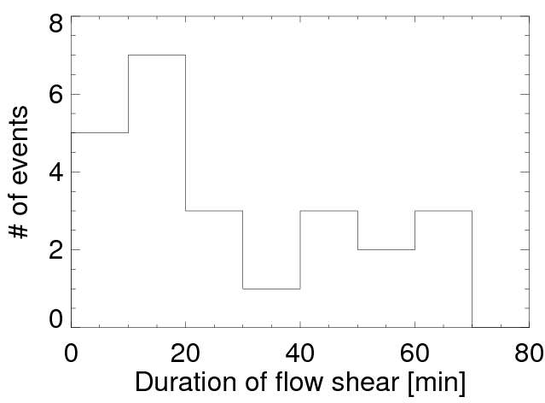
Statistics: Duration of flow shears
Most events last for ~ a few tens of min
Several events show longer durations of ~1 hour

Slide 14
Comparison with auroral oval latitude simultaneously observed by NOAA/POES
Auroral electron and ring current ion by NOAA/POES
flow shear
e- auroral oval
Ring current ion
Criteria of
|ΔMLT| < 1 hr,
|Δt| < 15 min,
select 12 events (out of 26) as a close-conjunction event w/ NOAA satellites
AACGM-Eastward flow (assuming L-shell flow with smoothing in MLT

Slide 15
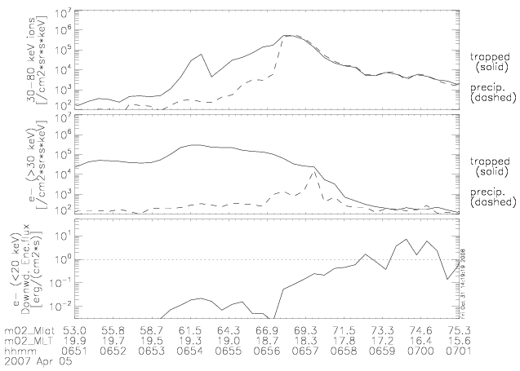
v.s. e- precipitation (electron aurora) bounrary
RC ions
30-80 keV
Electron
>30 keV
Downward electron energy flux (<20 keV)
Auroral particle
Criteria for the oval:
Down e- flux > 0.1 mW/m^2
Yes, they are in the sub-auroral region …

Slide 16
v.s. Precipitating RC/PS ion boundary
RC ions
30-80 keV
RC ions can generate conductance of ~ several S [Fang et al., 2007]
Electron
>30 keV
Downward electron energy flux (<20 keV)
Auroral particle
Flow shears (and eastward flows) are located at lower latitudes than the conductive layer of the ionosphere

Slide 17
v.s. Trapped RC ion boundary
RC ions
30-80 keV
Electron
>30 keV
Downward electron energy flux (<20 keV)
Auroral particle
For two of these three, NOAA paths were located at slightly earlier MLT than FSs. For the rest one (20070826), the oval boundary and prep. RC ion boundary were very close to each other. (SAPS not developed much?)

Slide 18
Statistics: Substorm or DP2 decay
For all (18) flow shear events mostly during Y2007
Definition of “substorm”
Bay-type H decrease of |ΔH| > 100 nT
positive bay of |ΔH| > 10 nT
(based on U.S. and Canadian magnetometers)
 | Expansion phase | Recovery phase | (unclear) | TOTAL
During substorm | 6 (*) | 2 | 1 | 9
Non-substorm period | - | - | - | 9
More often during substorm expansion than recovery
Associated with growth of partial ring current
Also found during non-substorm period
 | Assoc. with DP2 decay | No clear geomag. sig | TOTAL
Non-substorm period | 6 | 3 | 9
(*) including one event associated with reintensification during recovery

Slide 19
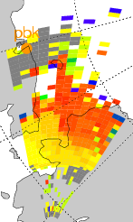
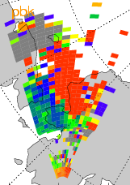
Interpretation: Emergence of R2 FAC/convection vortex
Similar to overshielding during storms
Convection weakens or partial ring current intensifies relatively
Dominated by convection (R1 FAC)
Change quickly (~ mins)
Upward FAC (R1)
Sheet-like structure in longitudinal dir.
Downward FAC (R2)

Slide 20
Conclusion
We examined the spatial and temporal properties of the flow shears which emerged transiently in the evening sector.
Eastward flows of ~ 50–100 m/s emerged transiently on the lower-latitude side (part?) of SAPS, forming a flow shear (reversal).
Most of flow shears are found during substorms, while they can be found during non-substorm intervals, in association with decay of the DP2 current system.
An interpretation would be that the eastward flows (and resultant flow shears between them and SAPS) correspond to the lower-latitude portion of the downward FAC-driven convection cell dominating temporarily the upward FAC-driven cell in the sub-auroral region.
The reason why flow shears can be generated during periods of substorm and DP2 decay would be that dynamic (maybe rapid) changes of balance between R1 and R2 FACs occur.
Future works
Current closure around the flow shear region

